Slide 1



New York
Manila
Boarding Pass
Passenger Name:
Airline
Tickets Issue Analysis
Shereen Hesham
Flight:
A1234
Seat:
1A
Gate:
A 12
Date:
December 7, 2025

Slide 2

New York
Manila
Boarding Pass
Table of Contents
Introduction
Description of the data
Data Preparation
Cleaning and Transforming data
Data Visualization
Visualize Data using appropriate Charts
Conclusion
Summarizes My Findings And Insights
Suggestions To Stakeholders

Slide 3
New York
Manila
Introduction

Slide 4
New York
Manila
Airline Tickets Data
We represent Airline Tickets data which is a data that consists of 13 columns which are:
TicketID CustomerName
Phone Email
Country Department
Issue Type Channel
Priority Status
DateOpened DateClosed
EstimatedCost
We can understand from columns that data express details for each customer like his email, his name, his phone and which channel that customer used to book ticket ,also issues that happened when customers booked ticket as issue`s type , which department that responsible for resolving it , which country its ticket had that issue, its priority,when it started ,when it has been resolved and its estimated cost to resolve that issue

Slide 5
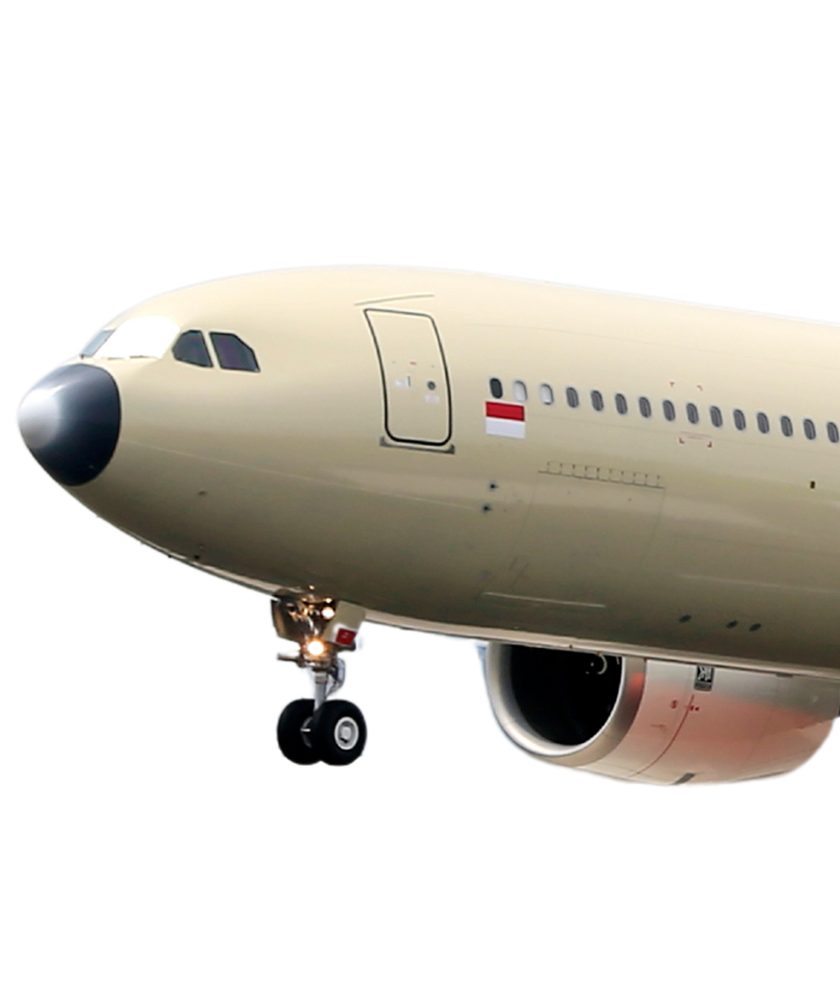
New York
Manila
Data Preparation
I have specified the appropriate type for each column ,I have seen if there was any duplication in my primary key which was TicketID but there was no duplication or empty cell, there was no problem with customer`s name column , In phone column made that each cell follow a consistent format and I dealed with empty cell as much as possible as if there was any customer that didn’t record his email and phone number when he booked his ticket but he has recorded them when he booked another ticket so I filled his empty data with that data but still phone column and email has empty cells ,In email column I made all emails be in format user@example.com, I made sure that country names and priority are spelled correctly and consistently, I made status column based on dateopened and dateclosed columns as it checked if issue is resolved or not as If there was no end date provided, I marked the status as "Open“ else “Closed” and Finally I made Duration of Solving the Problem column to tell us the duration that has been taken to resolve the issue

Slide 6
New York
Manila
Data Visualization
Total Tickets
10000
Total Customers
9404
Average of Duration of Solving Issue
89.98 days

Slide 7
New York
Manila
Data Visualization

Slide 8
New York
Manila
Data Visualization

Slide 9
New York
Manila
Data Visualization

Slide 10
New York
Manila
Data Visualization

Slide 11
New York
Manila
Data Visualization

Slide 12
New York
Manila
Data Visualization

Slide 13

New York
Manila
Conclusion
Most Channel that customers use to book tickets is Chat and the least one is Phone
All Issue types has closed distribution but the most issue type is Billing Error Issue and least one is Account Issue.
The most department that has issues is Finance Department as the most issue type that airport faces is Billing Error Issue also Logistics department is one of the most departments that has issues, and the least department is Operations.
The most Country its ticket has issues is Jordon and Lebanon.
Most Issues are from High Priority and Low Priority Type .
Most Issues are still not resolved and Closed issues are much less than Opened ones.
Billing Error Issue has the largest number of opened issues.
August has the largest no. of opened Issues during last two years.
During Last Two years always opened issues more than closed issues.
Average duration of solving Issue is 89.98 days.
Operations Department is the most time-consuming department in resolving issues.
The most expensive issue type to resolve is Damaged Product and Account issues.

Slide 14

New York
Manila
Recommendations to Improve Airline Ticket Issue Management
1. Optimize Resource Allocation
Increase staffing or shift resources to high-volume or slow-performing departments.
Provide targeted training on issue types with longest resolution times.
2. Enhance Channel Efficiency
Prioritize improvements in the most frequently used support channels (email/phone)
Introduce automation (auto-reply, chatbots) for common and repetitive issues.
3. Address Region-Specific Problem Areas
Analyse high-volume countries/locations and provide targeted support
Collaborate with local stations to resolve recurring regional issues

Slide 15
New York
Manila
Recommendations to Improve Airline Ticket Issue Management
4. Reduce Repetitive Issues Through Root Cause Analysis
Identify top recurring issue types and eliminate root causes
Create clear guides/FAQs for frequent issues to reduce incoming tickets
5. Forecast Peaks and Strengthen Seasonal Planning
Use historical trends to anticipate high-volume months
Adjust staffing levels during peak seasons

Slide 16

Thank You

